Slide 1
Windows 10 IoT and Raspberry Pi
By Lee Perkins

Slide 2
About Me
Lee Perkins
leep@tigerbase.com
Programming since 1981
Sr. Software Engineer @ IssueTrak
Frequently found here at HRNUG

Slide 3

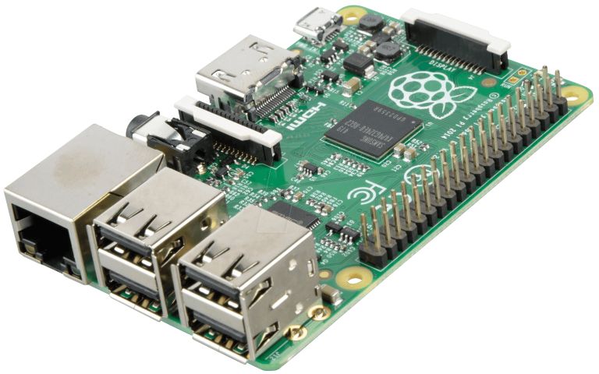
Raspberry Pi

Slide 4
Raspberry Pi
Intended to Promote Teaching Programming
900MHz Quad-Core ARMv7 Processor
1GB Ram, 4 USB, HDMI, Ethernet, Micro SD
Combined Audio/Composite video jack
40 General Purpose I/O (GPIO) Pins

Slide 5
Functions as First-Class Citizens
var myString = “Hello”;
var myFunc = function(name)
{
...
};
function someFunc(myFunc)
{
myFunc();
}
someFunc(function(){ ... });

Slide 6
3 Ways to Create an Object
var myObj = { };
var myObj = new Object( );
var myObj = Object.create(...);

Slide 7
4 Ways to Assign Key/Value Pairs (Properties/Methods)
Literal syntax (creates object and assigns at same time)
var myObj = { A: “Hi!”, B: 42 };
Dot syntax
myObj.A = function() { ... };
Square bracket syntax
myObj[“A”] = 42;

Slide 8
4 Ways to Assign Key/Value Pairs (Properties/Methods)
ECMA5 (IE9+, FF4+, CH5+) Object.defineProperty( myObj, “A”, { value: 42, writable: false } );
Object.defineProperties( myObj, {“A”: { ... }, “B”: { ... } } );

Slide 9
Property Setter / Getter functions
Object.defineProperty( myObj, “A”, { get: function() {
return ...; }, set: function(value) {
... = value; }, }

Slide 10
Constructor Functions
function Vehicle(model, year, miles)
{
this.Model = model;
this.Year = year;
this.Miles = miles;
this.toString = function( )
{
return this.Model + “ has ” +
this.Miles + “ miles.”;
};
}
var civic = new Vehicle(“Honda Civic”, 2009, 20000);
var mondeo = new Vehicle(“Ford Mondeo”, 2010, 5000);
alert(civic.toString( ));

Slide 11
Prototypes
function Vehicle(model, year, miles)
{
this.Model = model;
this.Year = year;
this.Miles = miles;
}
Vehicle.prototype.toString = function( )
{
return this.Model + “ has ” +
this.Miles + “ miles.”;
};
var civic = new Vehicle(“Honda Civic”, 2009, 20000);
var mondeo = new Vehicle(“Ford Mondeo”, 2010, 5000);
alert(civic.toString( ));

Slide 12
Prototype-less Chart

Slide 13
Prototype Chart

Slide 14
Object Prototype Chart

Slide 15
civic->Car->Vehicle chart

Slide 16
Inheritance with Prototypes
function Vehicle(model, year, miles)
{
this.Model = model;
this.Year = year;
this.Miles = miles;
}
Vehicle.prototype.toString = function( ) { ... };
function Car(model, year, miles, doors)
{
Vehicle.call(this, model, year, miles);
this.Doors = doors;
}
Car.prototype = Object.create(Vehicle.prototype);
Car.prototype.constructor = Car;
Car.prototype.drive = function( ) { ... };
var civic = new Car(“Honda Civic”, 2009, 20000, 2);

Slide 17
Private Members
function Vehicle(model, miles)
{
// Private
var _model = model;
var _miles = miles;
var _instance = { };
// Public
Object.defineProperty(_instance, “Model”,
{
get: function( ) { return _model; },
set: function(value) { _model = value; }
});
_instance.toString = function( )
{ return _model + “ has ” + _miles + “ miles.”; };
return _instance;
}
var civic = new Vehicle(“Honda Civic”, 2009, 20000);
alert(civic.toString( ));
alert(civic._model); // ERROR – No property on civic

Slide 18
Private Members
function Vehicle(model, miles)
{
// Private
var _model = model;
var _miles = miles;
// Public
Object.defineProperty(this, “Model”,
{
get: function( ) { return _model; },
set: function(value) { _model = value; }
});
this.toString = function( )
{ return _model + “ has ” + _miles + “ miles.”; };
}
var civic = new Vehicle(“Honda Civic”, 2009, 20000);
alert(civic.toString( ));
alert(civic._model); // ERROR – No property on civic

Slide 19
Type definition in C#
public class Person
{
public string Name { get; set; }
public int Age { get; set; }
public Person(string name, int age)
{
this.Name = name;
this.Age = age;
}
public int IncrementAge()
{
this.Age++;
return this.Age;
}
}
...
Person myPers = new Person(“John Doe”, 23);

Slide 20
Type definition in JavaScript
function Person(name, age)
{
this.Name = name;
this.Age = age;
}
Person.prototype.IncrementAge = function() {
this.Age++;
return this.Age;
};
...
var myPers = new Person(“John Doe”, 23);

Slide 21
Solitaire in OOP(ish) JavaScript

Slide 22
Anatomy of a Solitaire Game

Slide 23
Solitaire Class Hierarchy

Slide 24
“World” & “View” Coordinates

Slide 25
Solitaire – Code Time
Time for code!

Slide 26
Thank You
Thank you!
Now go forth,
Inherit,
and Instantiate!

